Slide 1
How to Understand the Holy Spirit
By the end of this course you will learn:
Who the Holy Spirit Is
The Purpose(s) of the Holy Spirit
Why We Need the Holy Spirit
How We Come To Know the Holy Spirit
How the Holy Spirit is Manifested
How to Get the Most From Our Relationship

Slide 2
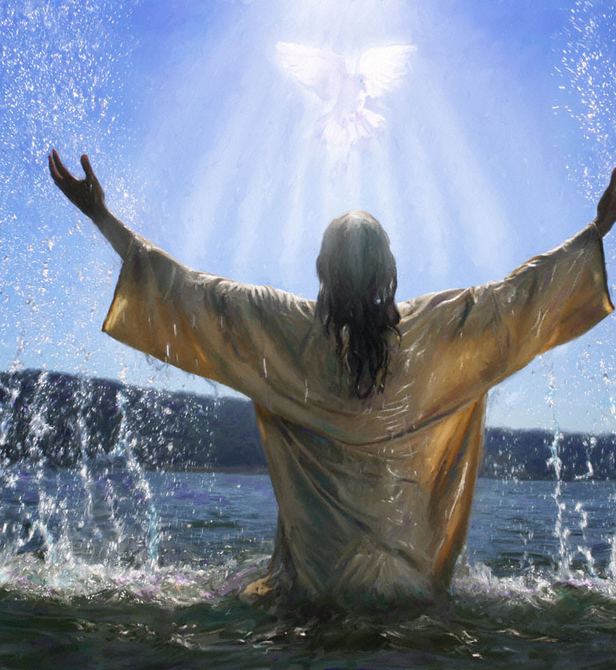
Who Is the Holy Spirit?
The Holy Spirit….
Is the voice of God who speaks to us and through us:
John 16:12-14 (Note: Holy Spirit is referred to as “He” not It)
“The Word” is what gives voice to The Holy Spirit– John 1:1-4; John 6:63
Revelation 2:7; 2:11; 3:8 (we must have an ear to hear the Spirit-- (at the end of each of the 7 churches in revelation)
John 10:1-5; 14-16

Slide 3
Who Is the Holy Spirit?
The Holy Spirit….
Is our power source…
John 1:14…11-12
Acts 1:8-9
Acts 2:1-4

Slide 4
What are the Purposes of the Holy Spirit?
Communion
Regeneration
Repentance and Faith
Sanctification

Slide 5
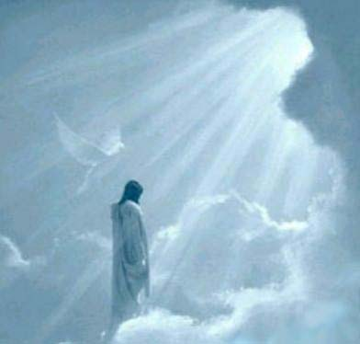
What are the Purposes of the Holy Spirit?
Communion
Greek—means partnership, participation, fellowship; interaction, communication.
2 Corinthians 13:14
John 14:16-17, 26
Romans 8:26-27
Titus 3:4-8

Slide 6
Regeneration
Regeneration means rebirth; or to be born again. Also, synonymous with renovation, restoration.
Titus 3:4-8
Note: the necessity of new regeneration grows out of the incapacity of the natural mind of man to see or enter (without help) into the Kingdom of God.
1 Corinthians 2:14

Slide 7
Repentance and Faith
◦We believe the scriptures teach that repentance and faith are sacred duties, and also inseparable graces, wrought in our souls by the regenerating Holy Spirit of God; whereby being deeply convinced of our guilt, danger and unfeigned contrition confession, and supplication for mercy. (Psalm 51; Luke 15:18-21; 18:13; John 16:8; Acts 2:37-38; 11:18; 16:30-31; Romans 10:12-13; Second Corinthians 7:11; Ephesians 2:8-9; James 4:7-10; First John 5:1). Additional scriptural support includes (Psalm 2:6; Acts 3:22-23; Romans 10:9-10; Second Timothy 1:12; Hebrews 1:8; 4:14; 7:25).

Slide 8
Sanctification
◦We believe the scriptures teach that sanctification is the process by which, according to the will of God, we are made partakers of His holiness; that it is a progressive work; that it is begun in regeneration; and that it is carried on in the hearts of believers by the presence and power of the Holy Spirit, the Sealer and Comforter, in the continual use of the appointed means especially the Word of God, self examination, self denial, watchfulness, and prayer. (Proverbs 4:18; Matthew 26:41; Luke 9:23; 11:35; John 3:6; Second Corinthians 7:1; 13:5, 9; Ephesians 1:4; 4:11-12, 30; 6:18; Philippians 1:9-12; 2:12-13; 3:12-16; First Thessalonians 4:3; 5:23; Hebrews 6:1; First Peter 2:2; Second Peter 1:5-8; 3:18; First John 2:20).

