Slide 1
What are the Purposes of the Holy Spirit?
Communion
Regeneration & Renewal
Assistance with “The Struggle”
Repentance and Faith
Sanctification

Slide 2
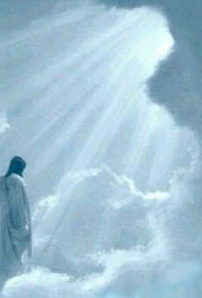
What are the Purposes of the Holy Spirit?
Communion- 2 Corinthians 13:14
Greek—means partnership, participation, fellowship; interaction, communication.
It can also mean to bare inner witness (to testify of the existence of something). Romans 8:14-17
Communion (Inner witness) takes place in our:
Hearts-- Romans 5:5, Galatians 4:6
Minds (Conscience)-- Romans 9:1 [cp- 1 Tim 4:1-2]; Ephesians 1:15-21; John 14:16, 26
Souls– Jeremiah 31:25; [Satiate-Fill to the full]; Joel 2:28-29; Luke 24:49; Acts 1:8; [Endued- to be clothed with][Acts 2:1-4; 2:15-18] Ephesians 3:14-19; John 7:38.
Bodies: (Eyes, Ears, Mouth– 1 Corinthians 2:9-16; John 16:13-14; 1 Kings 19:9-12; Isaiah 30:21)

Slide 3
What are the Purposes of the Holy Spirit? To Assist in The Struggle
The Struggle
There are at two realms we have to deal with: the flesh and the Sprit. John 3:6
The Spirit and Flesh are contrary to each other. Galatians 5:16-18
Flesh is Weak Even though The Spirit is Willing. Therefore, we need some help. Matthew 26:41
We need help with the flesh because the flesh is not profitable. John 6:63
We have to deal with the flesh because it blocks us from entering into God’s presence. 1 Corinthians 1:29, Romans 8:8
We are wrestling with a crafty opponent. Ephesians 6:12

Slide 4
What are the Purposes of the Holy Spirit? To Assist in The Struggle
The Strategy for The Struggle
Romans 7:14-25 (Handout)
Romans 8:5-13 (Flesh = Carnality); is a function of what we think about.
Mortify = Greek– to make to die, i.e. destroy, render extinct; b.) by death to be liberated from the bond of anything, literally to be made dead.

